Slide 1

OpenAgile Overview

Slide 2
OpenAgile Overview
What is OpenAgile?
A method for organizations, teams and individuals to...
Increase Productivity and Quality
Allow Innovation and Respond to Change
Increase Team Spirit and Personal Engagement
Create a Culture of Continuous Improvement
Reduce Costs and Risk
✔

Slide 3
OpenAgile Overview
What is OpenAgile?
OpenAgile
is a
Value Delivery System &
Learning System &
Learning Community
Note: OpenAgile is not just for software or technology!!!

Slide 4
OpenAgile Overview
What is OpenAgile?
Purpose of OpenAgile
is:
To create an environment in which people are free to express their true nature and capacities to contribute to the betterment of their organization.

Slide 5
OpenAgile Overview
Who is Using OpenAgile?
Suncor Energy
Oilsands mining projects and operations
Equitable Life Insurance
IT projects
ING Romania
Sales management team

Slide 6

OpenAgile
Foundations
OpenAgile
requires
Truthfulness
honesty, integrity, transparency, self-awareness

Slide 7
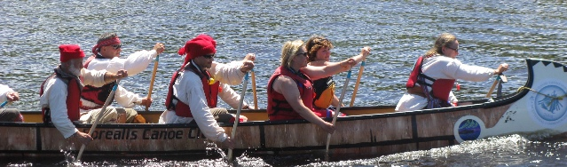
OpenAgile
Foundations
OpenAgile
requires
Consultative Decision-Making
freedom to speak, search for truth, unified action

Slide 8
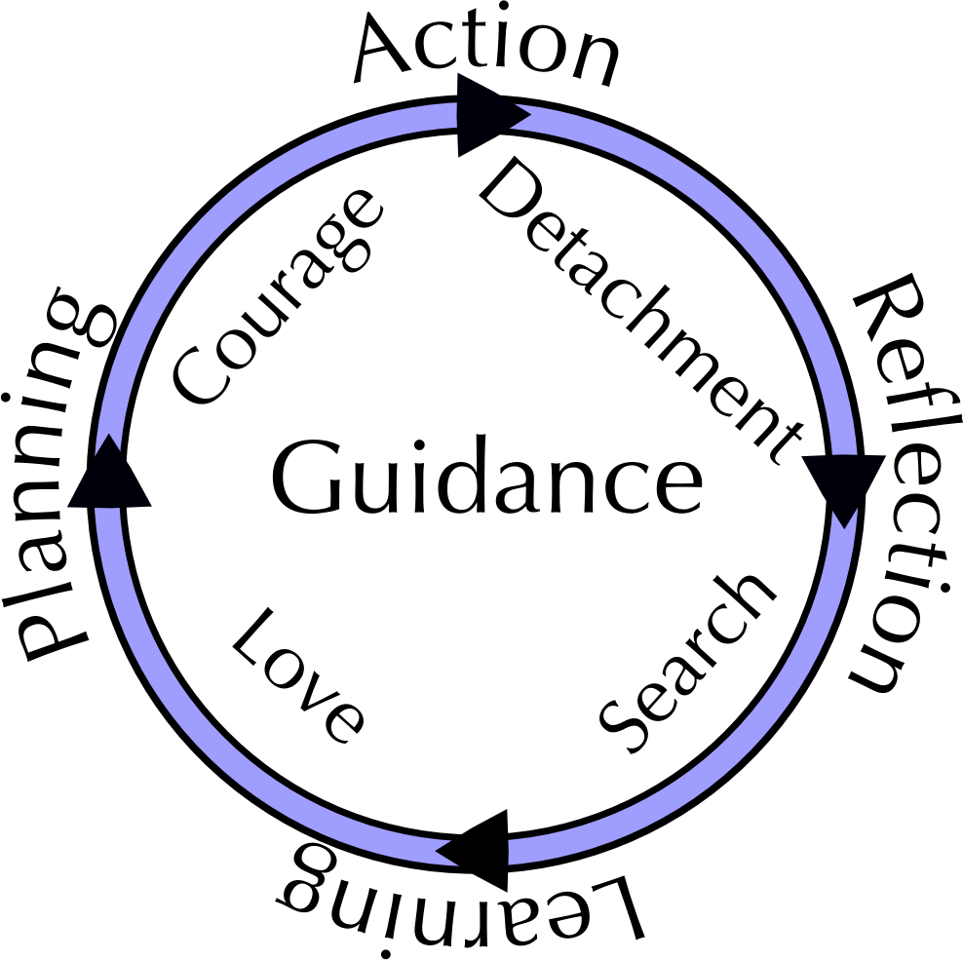
OpenAgile
Foundations
OpenAgile
requires
Systematic Learning

Slide 9
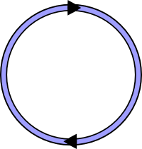
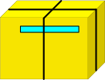
OpenAgile Overview
The Big Picture
Cycle 1
GOAL
Work towards a clear goal or purpose.
Break up the work into short Cycles.
Deliver valuable results at the end of every Cycle.
Notes:
- every iteration the same length
- complete deliverable
- no ups and downs for staffing or effort

Slide 10

OpenAgile Overview
The Big Picture
Cycle 1
Cycle 2
Cycle 3
Cycle 4
GOAL
Each Cycle builds on the results of previous Cycles and every
Cycle is the same length of time.
(For projects there should be at least five Cycles from start to finish
to allow for suitable amounts of feedback and learning.)
Notes:
- every iteration the same length
- complete deliverable
- no ups and downs for staffing or effort

Slide 11
OpenAgile Overview
Value Drivers
Value Drivers are the things you work on during a Cycle and which you need to do to deliver value towards the Goal
Value Drivers are prioritized into a list, usually with highest value at the top
The list of Prioritized Value Drivers is used at the start of each Cycle to determine what activities occur during the Cycle
A single Value Driver may be started and finished in one Cycle, take multiple cycles to complete, or be indefinite in duration
$$$$
$$
$
Notes:
Simultaneous work is one of the biggest mindset challenges... however, only discuss this if it is brought up by someone in the class. It will be covered in the Iterations module.

Slide 12

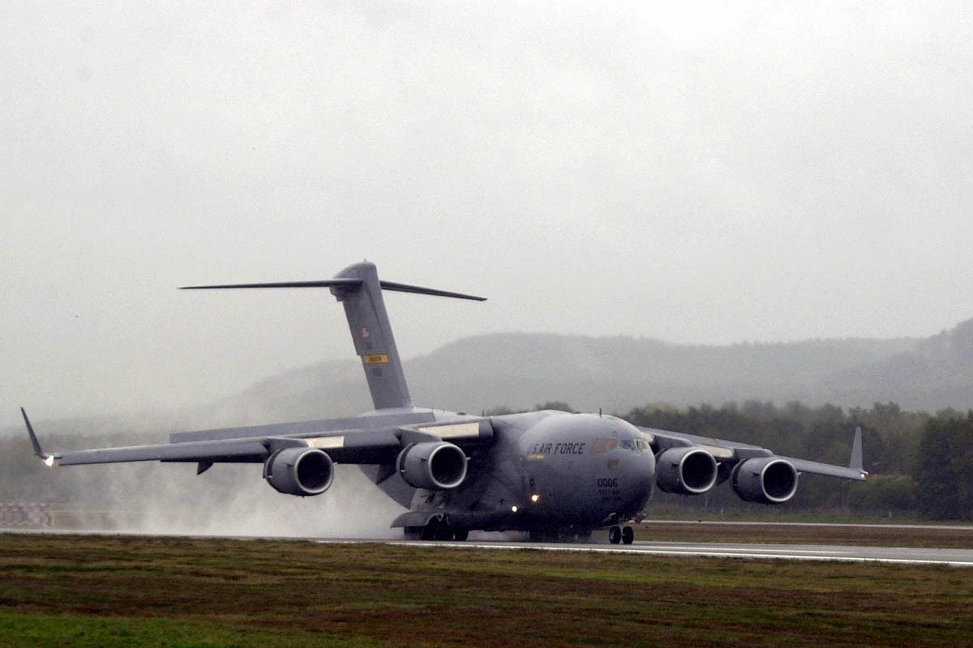
OpenAgile Overview
Organic Growth
vs.
- not an airplane until it is “finished”
- built according to detailed plan
- built in stages
- more fragile as it ages
- always a tree
- adapts as it grows
- seasons are its Cycles
- stronger as it ages
Each Value Driver is like a ring of growth on a tree... not a part of an airplane

Slide 13
OpenAgile Overview
Inside a Cycle
Engagement
Meeting
TIME (not to scale)
Work Period
Work Period
Work Period
Work Period
Work Period
Reflection
Learning
Planning
Progress Meeting
Progress Meeting
Progress Meeting
Progress Meeting
Everything is timeboxed, in proportions determined by the team.
A Cycle should have at least four Progress Meetings and no more
than twenty.
Notes:
Simultaneous work is one of the biggest mindset challenges... however, only discuss this if it is brought up by someone in the class. It will be covered in the Iterations module.

Slide 14
OpenAgile Overview
The Engagement Meeting
Purpose: to take some time for systematic and practical learning
Attendees: all individuals doing work to deliver Value Drivers (the “team” or the “community”)
Agenda: “Reflect”, “Learn” and “Plan”
Outcome: a “Cycle Plan”
Engagement
Meeting
Reflection
Learning
Planning
Notes:
Simultaneous work is one of the biggest mindset challenges... however, only discuss this if it is brought up by someone in the class. It will be covered in the Iterations module.

Slide 15
OpenAgile Overview
The Engagement Meeting
Each Cycle starts with the Engagement Meeting:
  Reflection: What happened during the last Cycle, what were the results?
Value Drivers
Results from
Previous Cycle
Cycle Plan
Task
Task
Reflection
Learning
Planning
Task
Task
Task
Task
Task
Task
Task
Task
Task
Task

Slide 16
OpenAgile Overview
The Engagement Meeting
Each Cycle starts with the Engagement Meeting:
  Reflection: What happened during the last Cycle, what were the results?
  Learning: What did we learn, what new principles have we identified, what new skills have we developed, how should we change our Value Drivers?
Value Drivers
Results from
Previous Cycle
Cycle Plan
Task
Task
Reflection
Learning
Planning
Task
Task
Task
Task
Task
Task
Task
Task
Task
Task

Slide 17
OpenAgile Overview
The Engagement Meeting
Each Cycle starts with the Engagement Meeting:
  Reflection: What happened during the last Cycle, what were the results?
  Learning: What did we learn, what new principles have we identified, what new skills have we developed, how should we change our Value Drivers?
  Planning: What will we do during this Cycle, what Tasks are required to deliver value?
Value Drivers
Results from
Previous Cycle
Cycle Plan
Task
Task
Reflection
Learning
Planning
Task
Task
Task
Task
Task
Task
Task
Task
Task
Task

Slide 18
OpenAgile Overview
The Cycle Plan
The Engagement Meeting results in a Cycle Plan that includes many Tasks. There are five core types of Tasks:
New Artifacts
Repetitive Activities
Quality Problems
Obstacles
Calendar Events

Slide 19
OpenAgile Overview
The Cycle Plan
A single Value Driver is decomposed into multiple Tasks. Remembering the five core types of Tasks is a way to ensure that this decomposition is effective:
Some Value Drivers may translate to only a small number of Tasks:
Value Driver
Value Driver

Slide 20
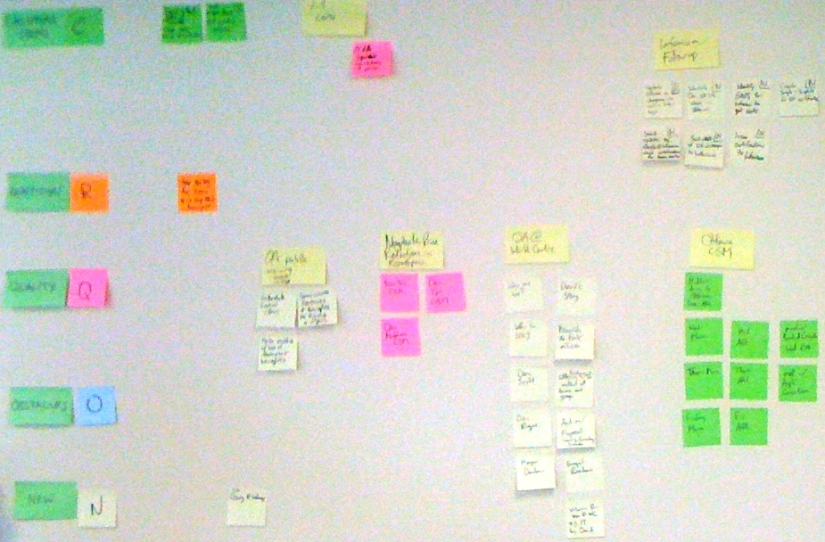
OpenAgile Overview
The Cycle Plan
Teams should make their Cycle Plan visible. Displaying Value Drivers and Tasks on a wall is a good way to do this:

Slide 21
OpenAgile Overview
Going Through a Cycle
Engagement
Meeting
TIME (not to scale)
Work Period
Work Period
Work Period
Work Period
Work Period
Reflection
Cycle Plan
Learning
Planning
Progress Meeting
Progress Meeting
Progress Meeting
Progress Meeting
Task
Task
Task
Task
Task
Task
Task
Task
Task
Task
Task
Task
The Cycle Plan has many Tasks
Notes:
Simultaneous work is one of the biggest mindset challenges... however, only discuss this if it is brought up by someone in the class. It will be covered in the Iterations module.

Slide 22
OpenAgile Overview
Going Through a Cycle
Engagement
Meeting
TIME (not to scale)
Work Period
Work Period
Work Period
Work Period
Work Period
Reflection
Learning
Planning
Progress Meeting
Progress Meeting
Progress Meeting
Progress Meeting
During a Work Period, Team Members work on Tasks.
Notes:
Simultaneous work is one of the biggest mindset challenges... however, only discuss this if it is brought up by someone in the class. It will be covered in the Iterations module.

Slide 23
OpenAgile Overview
Going Through a Cycle
Engagement
Meeting
TIME (not to scale)
Work Period
Work Period
Work Period
Work Period
Work Period
Reflection
Cycle Plan
Learning
Planning
Progress Meeting
Progress Meeting
Progress Meeting
Progress Meeting
Task
Task
Task
Task
Task
Task
Task
Task
Task
Task
Over time, Tasks are completed and new Tasks may be added...
Interruptions are made visible and tracked as new Tasks – a team
uses Commitment Velocity to allow for expected levels of interruption.
Notes:
Simultaneous work is one of the biggest mindset challenges... however, only discuss this if it is brought up by someone in the class. It will be covered in the Iterations module.

Slide 24
OpenAgile Overview
Going Through a Cycle
Engagement
Meeting
TIME (not to scale)
Work Period
Work Period
Work Period
Work Period
Work Period
Reflection
Cycle Plan
Learning
Planning
Progress Meeting
Progress Meeting
Progress Meeting
Progress Meeting
Task
Task
Near the end of the Cycle, most Tasks should be complete.
Notes:
Simultaneous work is one of the biggest mindset challenges... however, only discuss this if it is brought up by someone in the class. It will be covered in the Iterations module.

Slide 25
OpenAgile Overview
Progress Meetings
The Team meets at least four times per Cycle to engage in:
  Reflection:
    What happened, what did you see and what Tasks did you do?
  Learning:
    What did you learn?
  Planning:
    What will happen, what Tasks will you do?
Engagement
Meeting
TIME (not to scale)
Work Period
Work Period
Work Period
Work Period
Work Period
Reflection
Learning
Planning
Progress Meeting
Progress Meeting
Progress Meeting
Progress Meeting

Slide 26
OpenAgile Overview
Roles and Paths of Service
Team Member:
Performs work, committed to the goal, and creates value for stakeholders
Paths of Service:
Ways that Team Members can help the team become more effective
    Growth Facilitation: Team Member(s) who promote organic growth and
    the skills to work this way
    Process Facilitation: Team Member(s) who facilitate the application of OpenAgile foundations and practices
Stakeholders /
Customers /
Sponsors
Team
GF
PF

Slide 27
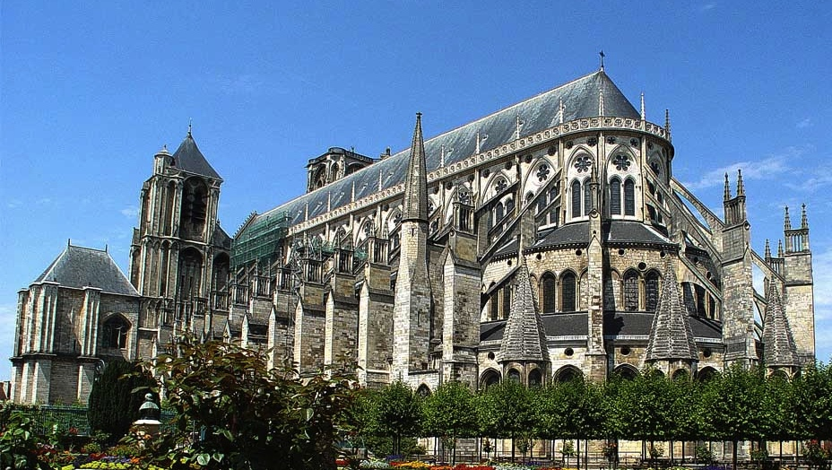
OpenAgile Overview
Team Self-Organization
Team Members are committed to the overall goal!
Not stone-cutters
Not wage-earners
Cathedral builders!

Slide 28
OpenAgile Overview
Team Self-Organization
Team Members communicate about work throughout the Cycle!
Cycle Plan
Task
Task
Task
Task
Task
Task
Blah blah blah blah!!!!
I like peanuts and celery.
How many tasks did you do?
Don't be shy!!!!
Task
Task
Task
Task
Task

Slide 29
OpenAgile Overview
Team Self-Organization
Team Members volunteer for Tasks as the Cycle progresses!
Sometimes a Task is a
natural fit for a particular
Team Member.
Cycle Plan
Task
Task
Task
Task
Task
Task
Task
Task
Task
Task
Task
Task
Task
Task

Slide 30

OpenAgile Overview
Team Self-Organization
Team Members self-organize like geese flying in formation.

Slide 31
OpenAgile Overview
Delivering Value
For Projects:
Avoid risky bet-the-business efforts
Deliver value continuously
Incremental Value Delivered
Traditional end-of-project delivery
Stop Here!
$
$
$
Preparation
$
$
$
Minimum Return
Cost of Team
Time (1 tick mark = 1 Cycle)

Slide 32
OpenAgile Overview
Delivering Value
For Operations:
Avoid increasing bureaucratic overhead (waste)
Deliver better value, more efficiently
Incremental Value Delivered
$
Cost of Operations
$
$
$
$
Time (1 tick mark = 1 Cycle)

Slide 33


OpenAgile Overview
Learning
Don't get stuck in bad behaviors and sub-optimal processes
Continuous improvement of:
  Results
  Process
  People
Capacity-building program for individuals, teams and communities: http://www.openagile.com/

Slide 34
OpenAgile Overview
Community
OpenAgile is open source: http://www.openagile.org/
  Community involvement in improving OpenAgile
OpenAgile has integrity
  Community uses OpenAgile to deliver value and learn
OpenAgile is being used in many industries:
  Sales for financial products
  Small business management
  Mining projects
  IT and technology R&D
  Volunteer communities

Slide 35
OpenAgile Overview
Benefits of OpenAgile?
A method for organizations, teams and individuals to...
Increase Productivity and Quality
Allow Innovation and Respond to Change
Increase Team Spirit and Personal Engagement
Create a Culture of Continuous Improvement
Reduce Costs and Risk
✔

Slide 36

OpenAgile Overview
Next Steps?
Questions?
Capacity-Building: OpenAgile.com
Community: OpenAgile.org
OpenAgile Transformation

